Slide 2
Agenda
Welcome & Opening Prayer
Goals & Terms
How Did We Get Here?
Overview of The Way Forward
Parable for Today
One Church Plan Overview
Connectional Conference Plan Overview
Traditionalist Plan Overview
What’s Happening Now?/What’s Next?
Closing Prayer

Slide 3
Goals
Understand and be able to explain The Way Forward to others
Understand the three plans from The Way Forward
Understand more about General Conference 2019
Be prepared to lead other small groups at DUMC

Slide 4
Affirmation from the Clergy
The clergy of Davidson UMC affirm the sacred worth of all people and we celebrate the diversity of God’s good creation.
We are grateful for the congregation of DUMC and look forward to the time when we can all sit together to share our personal beliefs, feelings, and stances about tonight’s subject. There will be a time for sharing with one another and listening to one another. That will be a sacred time for all of us!
This presentation is intended to share facts with each of you. We welcome your questions about the material presented. We ask that for the time being, we all wait to share our beliefs and stances until that time when we can do so as the body of Christ. We will plan that time and announce it well in advance.

Slide 5
Terms
General Conference (GC)
Policy-making body of the UMC. The only body that can make changes to the Book of Discipline.
Meets every 4 years
Presided over by Bishops, but Bishops do not vote
Each Annual Conference sends a delegation to General Conference. The delegation is made up of an equal number of clergy and laity. The size of each delegation is determined by the membership in the Annual Conference.
Annual Conference (AC)
An annual conference is a regional body of churches
Meets annually (in the US most meet in May and June)
Equal number of clergy and laity
DUMC belongs to the Western NC Conference (WNCC) – a little < 1100 churches
54 Annual Conferences in the US (overseen by 46 bishops); 75 in the Philippines, Europe, and Africa (overseen by 20 bishops)

Slide 6
Terms
Book of Discipline (BOD)
Fundamental book outlining the law, doctrine, administration, organizational work and procedures of The United Methodist Church
Social Principles
A document setting forth the basic position of The United Methodist Church on important social issues. The Social Principles represent the effort of the General Conference to speak to human issues in the contemporary world from a sound biblical and theological foundation. The Social Principles document is reviewed by each General Conference and is printed in full in The Book of Discipline.
Judicial Council
Nine persons elected by General Conference who rule on questions of constitutionality in church law and practice.

Slide 7
Terms
Jurisdiction/Jurisdictional Conference
The five geographic areas in the United States, each composed of several annual conferences as determined by the General Conference: North Central, Northeastern, South Central, Southeastern and Western.
The Southeastern Jurisdiction has 15 annual conferences
The Jurisdictional Conference meets every quadrennium. Each annual conference sends a jurisdictional conference delegation made up of an equal number of clergy and laity
The primary business of the jurisdictional conference is the election and assignment of bishops
Central Conference
One of seven geographic areas outside the territorial United States, each composed of annual conferences as determined by the General Conference.
Central Conferences have responsibilities similar to those of Jurisdictional Conferences.
The seven central conferences are in Europe, Africa and the Philippines.

Slide 8
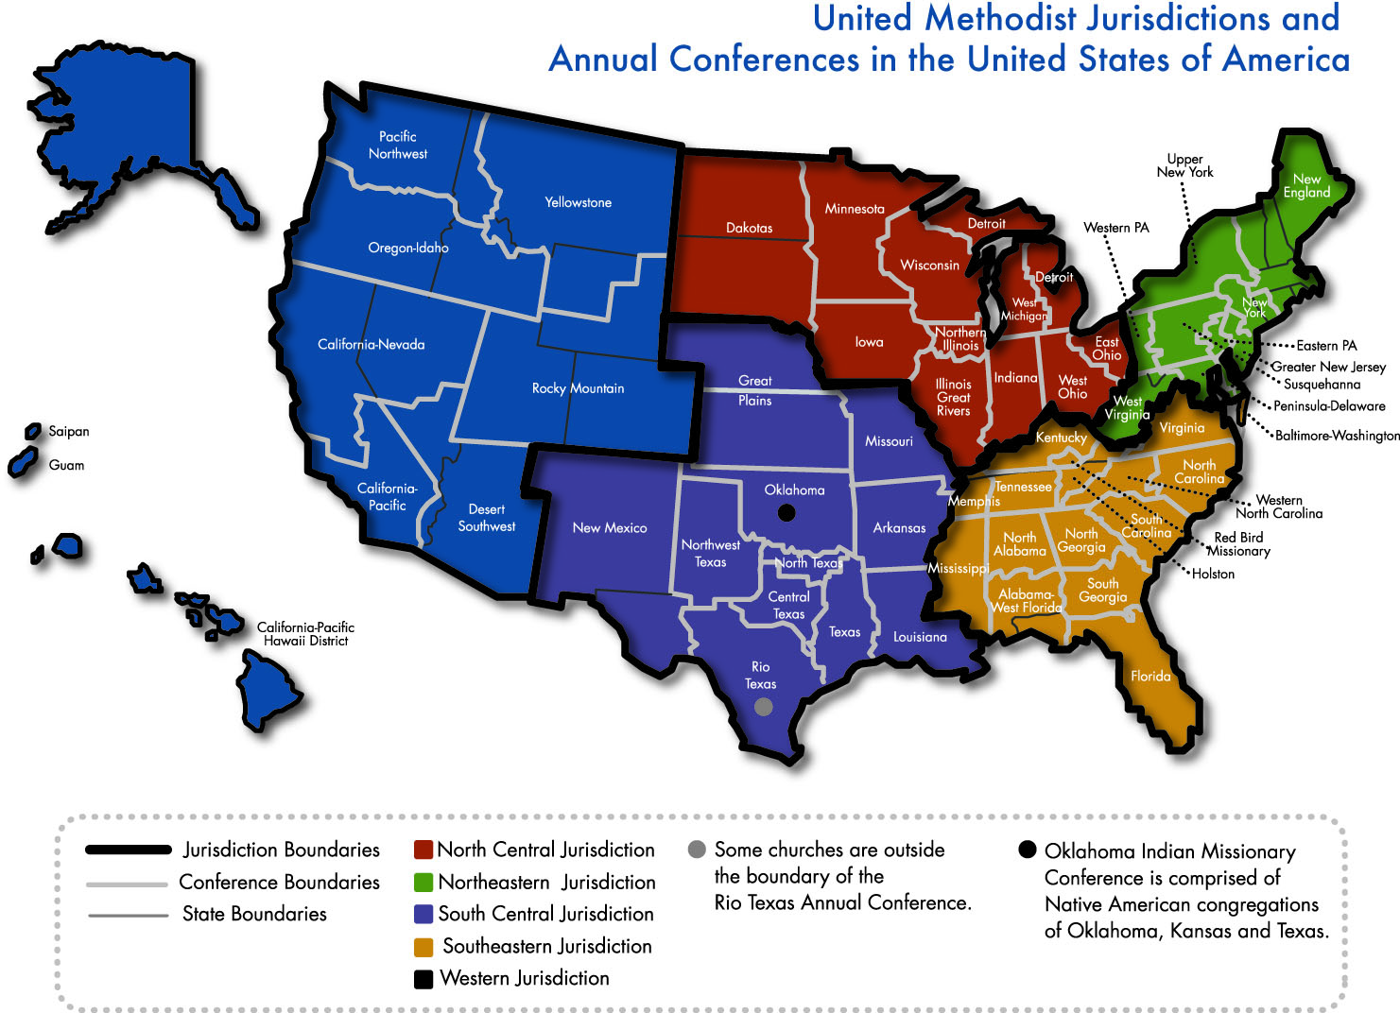

Slide 9
Central Conferences
http://s3.amazonaws.com/Website_Properties/who-we-are/documents/africa-central-conferences-map-revised.pdf
http://s3.amazonaws.com/Website_Properties/who-we-are/documents/europe-central-conferences-map-revised.pdf
http://s3.amazonaws.com/Website_Properties/who-we-are/documents/philippines-central-conferences-map-revised.pdf

Slide 10
How Did We Get Here?
The UMC began in 1968 and immediately appointed a committee to discuss sexuality
The Report on Homosexuality (1972):
“Homosexuals no less than heterosexuals are persons of sacred worth, who need the ministry and guidance of the church in their struggles for human fulfillment, as well as the spiritual and emotional care of a fellowship which enables reconciling relationship with God, with others and with self. Further, we insist that all persons are entitled to have their human and civil rights ensured.”

Slide 11
How Did We Get Here?
1972 General Conference adopted the Social Principles. It added the phrase, “We do not condone the practice of homosexuality and consider it incompatible with Christian teaching,” to the phrase, “persons of homosexual orientation are persons of sacred worth.”
1980 GC added to the Social Principles, “We affirm the sanctity of the marriage covenant, which is expressed in love, mutual support, personal commitment, and shared fidelity between a man and a woman.”

Slide 12
How Did We Get Here?
1984 Adopted, as a standard for ordained clergy, commitment to ‘fidelity in marriage and celibacy in singleness.”
1988 GC changed Social Principles to read, “Although we do not condone the practice of homosexuality and consider this practice incompatible with Christian teaching, we affirm that God’s grace is available to all. We commit ourselves to be in ministry for and with all persons.”

Slide 13
How Did We Get Here?
2004 “a bishop, clergy . . . may be tried when charged . . . with one or more of the following offenses: (a) immorality including but not limited to not being celibate in singleness or not faithful in heterosexual marriage”
General Conference debates continues
2012-2016 Connectional Table offered new recommendations to GC regarding sexuality with no change adopted

Slide 14
How Did We Get Here?
In the meantime…more than 100 United Methodist clergy and candidates have come out as gay and
Multiple conferences have urged noncompliance with church prohibitions related to homosexuality and
The Western Jurisdiction has elected and consecrated Bishop Karen Oliveto, who is openly gay and married.
GC 2016 - 850+ delegates in the legislative body (22 from WNCC). There were serious divisions with large lobbying groups on many sides of the issue. GC asked for bishops to lead in light of overwhelming number of proposals.
Council of Bishops proposed the creation of the Commission on A Way Forward. It was approved by the 2016 GC.

Slide 15
How Did We Get Here?
https://www.dropbox.com/s/5dm0zujnagto9cn/A%20Way%20Forward%20-%20Tom%20Berlin%20%28Sugar%20Packet%20Video%29.mp4?dl=0

Slide 16
“The Commission will bring together persons deeply committed to the future(s) of The United Methodist Church, with an openness to developing new relationships with each other and exploring the potential future(s) of our denomination in light of General Conference and subsequent annual, jurisdictional and central conference actions.”

Slide 17
Commission on A Way Forward
The members of the Commission were named 3 months after GC 2016 ended
32 people from 9 nations + 3 Bishop Moderators (1 woman)
8 Bishops, 11 laity, 13 clergy (11 elders and 2 deacons)
14 members (including 2 Bishops) were women
62% US 23% Africa 6% Europe 6% Philippines
All jurisdictions represented
Wide spectrum of positions and theology
Purpose: to do a complete examination and possible revision of every paragraph of the Book of Discipline concerning human sexuality and explore options that help to maintain and strengthen the unity of the church.

Slide 18
Commission on A Way Forward
SPIRITUAL PRACTICES
PRAYER: We pray together during the days we meet and covenant to pray for each other when apart.
STUDY: We study the Bible together.
LISTEN: We hear each other’s testimonies.
WORSHIP: We have spent time in worship.
HOLY CONFERENCING: We engage in Christian conversation throughout our meetings.
COVENANT: We have a covenant that creates a Spirit-led structure for mutual accountability in love

Slide 19
Commission on A Way Forward
FOCUS, FOCUS, FOCUS
MISSION: “Exploring the potential future(s) of our denomination in light of General Conference and subsequent annual, jurisdictional, and central conference actions”
VISION: “Maximize the presence of a United Methodist witness in as many places in the world as possible, that allows for as much contextual differentiation as possible, and that balances an approach to different theological understandings of human sexuality with a desire for as much unity as possible”
SCOPE: “Be open to new ways of embodying unity that moves us beyond where we are in the present impasse and cycle of action and reaction around ministry and human sexuality… Give consideration to greater freedom and flexibility to a future United Methodist Church that will redefine our present connectionality”

Slide 20
Commission on A Way Forward
THE PRINCIPLES OF A WAY FORWARD
Fruitfulness in Mission is First
Multiplying Wesleyan Witness
Operating out of a “Heart of Peace”
Allow for Contextualization of Structure
Creating “Space"
Simplicity of Proposal
Resolution of Impasse
Working with the Council of Bishops to prepare for General Conference

Slide 21
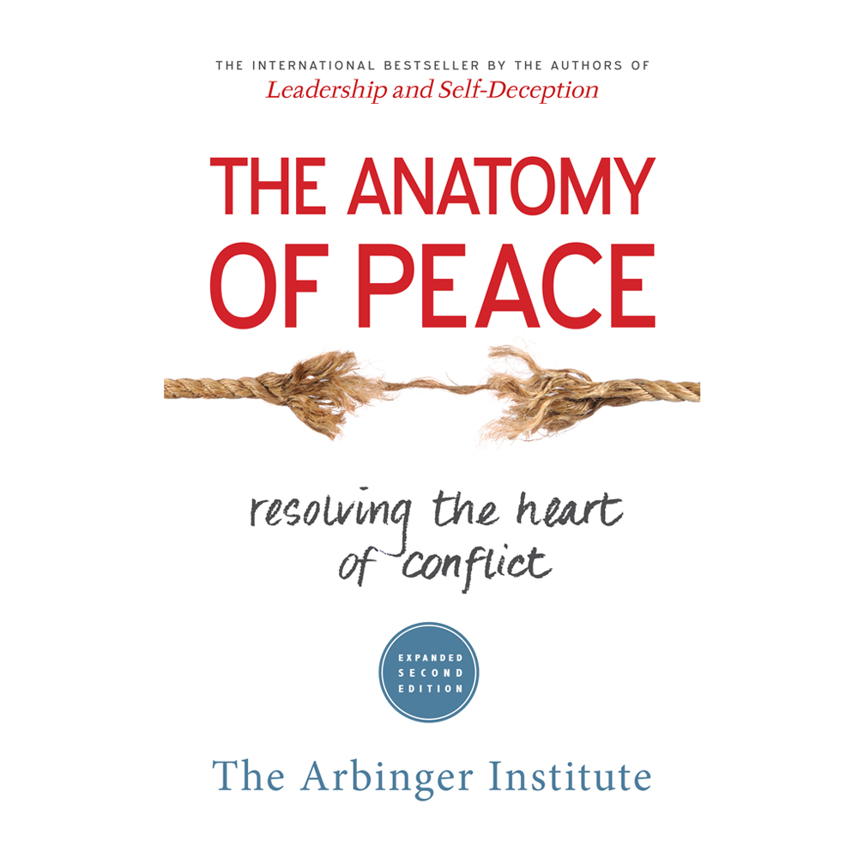
Commission on A Way Forward
PREPARING FOR A WAY FORWARD: Study “The Anatomy of Peace”
If we are truly committed to peacemaking — not just to proving ourselves right, the first thing we must do is to step out of the box that traps us in attitudes and behaviors that demonize others and work for a heart that is at peace. Then we must build relationships, both with others who might be able to influence the situation and with those we have treated as enemies. As we listen to and learn from those with whom we have been in conflict, they may become more open to our attempts to communicate our experience and point of view. When we more fully understand one another, we will be in a much better position to deal with the things that are going wrong and work together to make things go right. The most time and effort should be spent at the beginning steps of this process, which Yusuf and Avi present as a “Peacemaking Pyramid” (p. 211).

Slide 22
Commission on A Way Forward
LEARNED VALUES
We value pushing the pendulum toward looser on structure and contextualization and tighter on naming the essentials of theology and doctrine.
We wish to honor differences in practices and non-essentials for the sake of contextual mission.
We value simpler structure and processes and a thinner Book of Discipline.
We value remaining connected in mission.
We support the freedom to contextualize.
We are exploring many creative ways of living together including “branches,” “umbrella plans,” “affiliated connections,” “federated relationships,” and more

Slide 23
Commission on A Way Forward
OUR GLOBAL CONTEXT
Concerns and goals related to human sexuality vary widely across the globe.
The landscape in our Central Conferences is very different from the U.S. landscape.
Conferences are not of one mind on ordination and marriage of LGBTQ persons.
The global context is complex due to cultural, civic, and legal restrictions and freedoms that differ.
Some changes within the U.S. church may pose a potential threat to the vital mission of our Central Conferences.
Understanding and honoring the nuances of each central conference is critical.

Slide 24
Commission on A Way Forward
THE FINAL REPORT
English, French, Portuguese, and Swahili translations are available to read
Released on July 31, 2018
Here is the link to the English Version.

Slide 25
Parable for Today
https://www.youtube.com/watch?v=D8ZGS6Dpl9g&feature=youtu.be
“Working together has more to do with listening carefully to each other than claiming our position and speaking clearly.”
− GIL RENDLE
Self-Reflection: When have you been more concerned about claiming your own position than hearing others’ interests? When do you need to listen?

Slide 26
The One Church Plan
Would have the denomination recognize that marriage is between two adults, not explicitly between one man and one woman.
It would allow pastors to decide whether or not to preside at same-sex weddings, and it would give local churches the right to decide whether or not same-sex weddings could take place on church properties.
Finally, it would allow annual conferences (clergy session and Board of Ordained Ministry) to decide whether or not to ordain self-avowed, practicing homosexuals.
Local Church laity involvement will be able to decide whether weddings can take on church property (Church Conference votes). No vote unless the church desires change
Clergy will retain right to discern readiness for marriage
Would NOT require annual conferences to adopt Constitutional amendments.

Slide 27
The One Church Plan
Any questions about the plan?
What can you affirm in the One Church Plan?
What about the One Church Plan raises questions?

Slide 28
The Connectional Conference Plan
Would create three branches of the church, referred to as Connectional Conferences.
While the three branches would share responsibility and receive support from a number of general church boards and agencies and operate under a unified Council of Bishops, each branch would have a significant degree of autonomy when it comes to sexual ethics, teachings on marriage, and ordination standards.
Would require annual conferences to adopt a number of Constitutional amendments
Every Annual Conference will have to pass amendments by 2/3 of conference votes from ballots of all annual conferences

Slide 29
The Connectional Conference Plan
Any questions about the plan?
What can you affirm in the Connectional Conference Plan?
What about the Connectional Conference Plan raises questions?

Slide 30
The Traditional Plan
Would reaffirm The United Methodist Church’s present standard on human sexuality and call for enhanced accountability standards for clergy, bishops, and annual conferences.
United Methodist clergy would not be allowed to preside at same-sex weddings, and same-sex weddings would not be allowed on United Methodist property.
Self-avowed, practicing homosexuals would not be eligible for ordination in The United Methodist Church.
Self-avowed, practicing homosexuals and performing a same-sex wedding would be a chargeable offenses.
Would NOT require annual conferences to adopt Constitutional amendments.

Slide 31
The Traditional Plan
Any questions about the plan?
What can you affirm in the Traditional Plan?
What about the Traditional Plan raises questions?

Slide 32
What’s Happening Now?
The Judicial Council will meet in October to determine the constitutionality of the petitions which have been submitted to the Special Session of General Conference (Feb. 23-26, 2019 in St. Louis, MO). You can read the petitions here:
http://cdnfiles.umc.org/Website_Properties/who-we-are/judicial-council/judicial-council-dockets/docket-10-2018-12.pdf
The WNCC Delegation is meeting. They will be reading the “Anatomy of Peace” together in preparation for the GC. They are hoping to arrive at GC with hearts of peace. Please be in prayer for the delegation.
Other groups are also meeting and making plans for the GC and its aftermath. Some of these groups are:
Wesley Covenant Association (WCA)
Uniting Methodists
Reconciling Ministries Network (RMN)
Good News
Confessing Movement

Slide 33
Resources
https://www.wnccumc.org/healthyconversationsresources

Slide 34
Last Words and Closing Prayer
Bishop Ken Carter: Why the United Methodist Church Will Stay United
https://www.flumc.org/videodetail/why-i-believe-the-united-methodist-church-will-remain-united-8384939
Another Video Resource: Bishop Ken Carter’s address to the WNCC June 23, 2018
https://www.youtube.com/watch?v=r4UDtzh3y7s

